Slide 1
EduEasy Smart Learning Assistance System
2020-009

Slide 2
What is EduEasy ?
Smart learning assistant system.
Designed for university lecture room environment.
Why EduEasy ?
Overcome some major problems students face in traditional lecture room.
Main Objective
Develop an E-learning application for students to effectively learn and revise lectures done at the university.

Slide 3
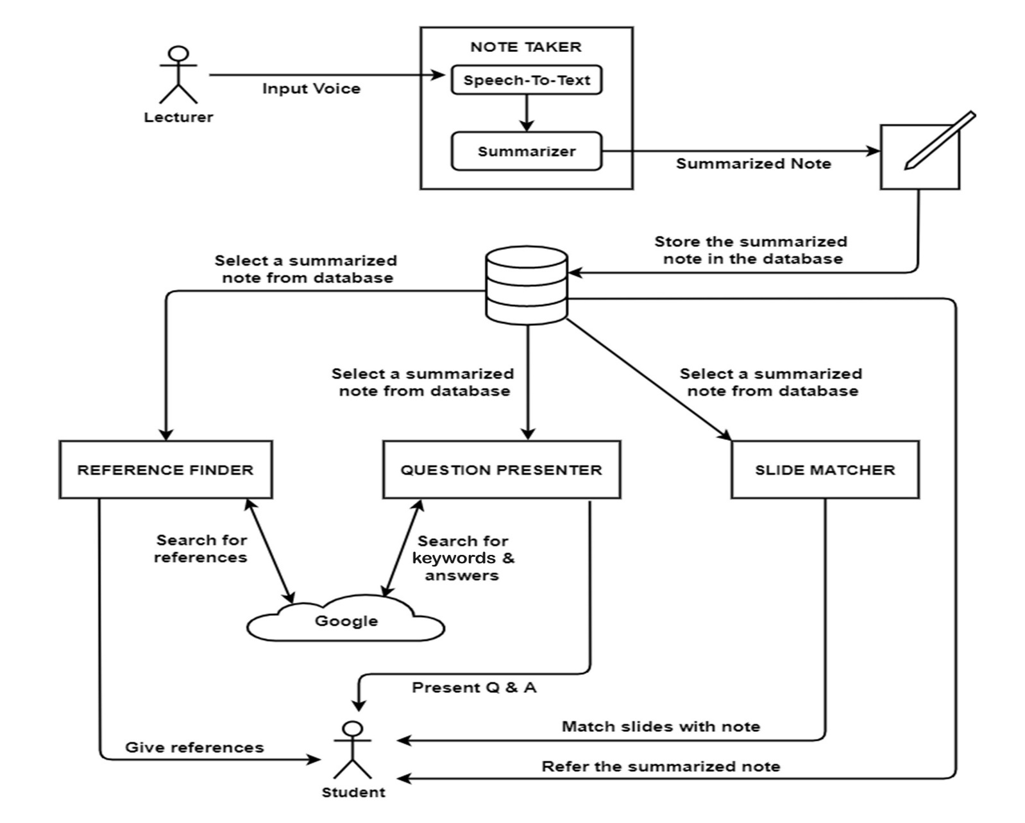
System Diagram

Slide 4

IT17112192 | Jayasuriya j. a. t. p.
Specializing in Information Technology
IT17112192 | Jayasuriya J. A. T. P. | 2020-009

Slide 5
The note taker
IT17112192 | Jayasuriya J. A. T. P. | 2020-009

Slide 6
Background & Research Gap
The definition of smart learning is constantly discussed by multidisciplinary scholars and educational professionals [1].
According to available resources, there are several systems developed related to smart learning.
So far, there is no simple, cohesive concept of smart learning.
The Note Taker is designed to do two particular tasks.
Convert the lecturer’s voice in to text and create a voice transcript.
Create a summarized note of the transcript.
IT17112192 | Jayasuriya J. A. T. P. | 2020-009

Slide 7
Background & Research Gap cont.
There are some previous researches done on these voice transcribing methods [2]-[3].
There are also researches done on automatic text summarization, text summarization machine learning algorithms etc. [4]-[6].
Comparison of effectiveness between those methods is a significant gap.
Done some calculations to determine the accuracy.
Opinions of readers matters the most.
IT17112192 | Jayasuriya J. A. T. P. | 2020-009

Slide 8

Background & Research Gap cont.
Online word processing tools like LinguaKit to summarize texts.
No research or product which is a combination of voice transcription and text summarization.
IT17112192 | Jayasuriya J. A. T. P. | 2020-009

Slide 9
Research Question
Students who study smart instead of study hard, can have good success in their education.
Studying smart is a challenge without correct support.
Most of the time university students do not have a proper lecture note for various reasons.
Do not attend lectures regularly, do not write down important points etc.
In exam times, have to waste time finding notes.
IT17112192 | Jayasuriya J. A. T. P. | 2020-009

Slide 10
Research Question cont.
The Note Taker component is designed to provide a solution for this problem.
This application generates a summarized note using a transcription of the lecturer’s voice.
Speech-to-Text converting facility is also provided.
After that, students are able to revise the notes.
IT17112192 | Jayasuriya J. A. T. P. | 2020-009

Slide 11
Objectives
Capture the lecturer’s voice using microphone and voice recorder.
Develop a speech-to-text converter to transcribe lectures into text.
Develop a text summarizer to summarize the transcription.
Conduct a research/survey to find out the most effective text summarization algorithm among popular algorithms.
Develop an attractive and easy to use user interface for the speech-to-text converter and the text summarizer.
IT17112192 | Jayasuriya J. A. T. P. | 2020-009

Slide 12

Methodology
Create a summarized
note
Voice is recorded to the computer
Transcribe audio into text format
Student can refer the summarized note
Edit and Submit
IT17112192 | Jayasuriya J. A. T. P. | 2020-009

Slide 13




Methodology cont.
Audio is converted to text using the SpeechRecognition interface of the JavaScript Web Speech API.
Transcribed text is converted into a summarized note using TF-IDF text summarization algorithm.
Python 3.6, Anaconda Spyder, Flask etc. used as tool and technologies.
IT17112192 | Jayasuriya J. A. T. P. | 2020-009

Slide 14
Achievements
Converting a long voice record into text takes a lot of time to process, but more accurate than converting speech-to-text real time using the SpeechRecognition API.
Word Error Rate (WER) of the transcriptions are around 30-35% in the speech-to-text converter.
80% of the respondents selected the summary of TF-IDF algorithm than Sentence Scoring algorithm.
IT17112192 | Jayasuriya J. A. T. P. | 2020-009

Slide 15
Achievements cont.
Results of the survey.
IT17112192 | Jayasuriya J. A. T. P. | 2020-009

Slide 16
References
[1] M. A. Awar, “Pioneering smart learning”. [Online]. Available: https://www.ellucian.com/emea-ap/insights/pioneering-smart-learning. [Accessed May 4, 2020].
[2] T. Kawahara, H.Nanjo and S. Furui, “Automatic transcription of spontaneous lecture speech,”in IEEE Workshop on Automatic Speech Recognition and Understanding, 2001, ASRU '01., Madonna di Campiglio, Italy, 2001, pp. 186-189.
[3] C. Munteanu, G. Penn, and R. Baecker, “Web-Based Language Modeling for Automatic Lecture Transcription,” in 8th Annual Conference of the International Speech Communication Association, Antwerp, Belgium, August, 2007, pp. 2353-2356.
[4] K. S. Thakkar, R. V. Dharaskar, and M. B. Chandak, “Graph-Based Algorithms for Text Summarization,” in 3rd International Conference on Emerging Trends in Engineering and Technology, Goa, India, 2010, pp. 516-519.
[5] N. K. Nagwani, S. Verma, “A Frequent Term and Semantic Similarity based Single Document Text Summarization Algorithm,” in International Journal of Computer Applications, March, 2011, vol. 17, no. 2.
[6] J. N. Madhuri, R. Ganesh Kumar, "Extractive Text Summarization Using Sentence Ranking," in 2019 International Conference on Data Science and Communication (IconDSC), Bangalore, India, 2019, pp. 1-3.
IT17112192 | Jayasuriya J. A. T. P. | 2020-009

Slide 17

IT17407458 | P. d. gallage
Specializing in Information Technology
IT17407458 | P. D. Gallage | 2020-009

Slide 18
THE REFERENCE FINDER
IT17407458 | P. D. Gallage | 2020-009

Slide 19
Background & Research Gap
Smart learning is a broad term for education in today’s digital age.
Advanced technologies are enabling learners to digest knowledge and skills more effectively, efficiently, and conveniently[1].
Referring the relevant reference materials is very important to university students.
There are two main functionalities in Reference Finder.
1. Referring the relevant reference materials automatically.
2. Generate a similarity value by comparing the original text with the reference text.
IT17407458 | P. D. Gallage | 2020-009

Slide 20
Background & Research Gap Cont.
Web scraping is one of the ways of extracting the phrases or words from the web pages.
R. Lawson [14] explains how to apply web scraping techniques using the BeautifulSoup library [15] to extract content from web sites easily .
This technique is very useful for developing automatic google searcher.
Cosine similarity is a measure of similarity between two non-zero vectors of an inner product space that measures the cosine of the angle between them [25].
It is used to compare similarity between two sentences or two texts.
IT17407458 | P. D. Gallage | 2020-009

Slide 21


Background & Research Gap Cont.
01
02
Learning resource finder.
Web application.
Search matching references for given key words.
Only have articles.
Only search in limited databases at California State University and some other university.
Learning resource finder.
Web application.
Search matching references for given key words.
Only have slide presentations.
No product or research has both functionalities of Reference Finder as one product.
IT17407458 | P. D. Gallage | 2020-009

Slide 22
Research Question
Referring the relevant reference materials is very important to all the students.
It helps to understand difficult lessons, formulas, theories, etc.
If unable to attend a one lecture, missed lot of important points.
Most of the students skip the process of understanding lessons by referring to references due to the limited time.
IT17407458 | P. D. Gallage | 2020-009

Slide 23
Objectives
Automatically search reference materials on the internet according to the selected keywords or keyphrases.
Generate a similarity value by comparing the original text with the reference text .
Save students time and effort for searching references.
Help to achieve students academic goals.
IT17407458 | P. D. Gallage | 2020-009

Slide 24



Methodology
Choose a summarized note form the database
Select key phrases (topic) for search
Cloud Database
Select most rated results
Automatic google search for references
Rate the websites according to the content of the summarized note
Retrieving all the results
Student can refer the relevant references
IT17407458 | P. D. Gallage | 2020-009

Slide 25
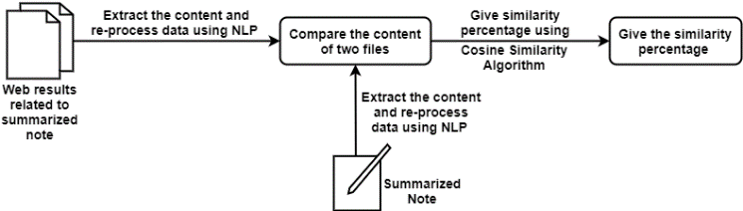
Methodology Cont.
Automatic reference finder has developed using web scrapping and python.
NLP (Tokenization & stop words) has used for re-process the data.
Content similarity value has generated using Cosine Similarity Algorithm.
Python 3.6, Anaconda Spyder, Flask etc. used as main tool and technologies.
IT17407458 | P. D. Gallage | 2020-009

Slide 26
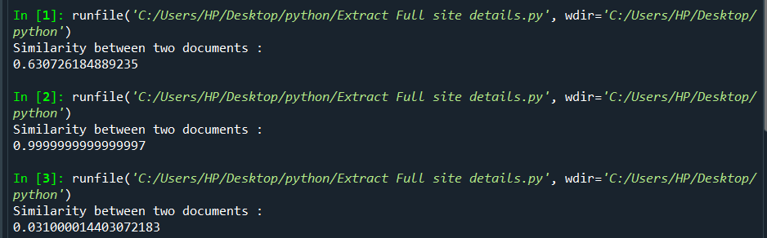
Achievements
Automatically google search the references according to the topic and demonstrate all the references in separate google tabs.
The results appear as YouTube videos, articles, books, and blogs, etc.
Generates a similarity value.
IT17407458 | P. D. Gallage | 2020-009

Slide 27
References
[1] [1] M. A. Awar, “Pioneering smart learning,”. [Online]. Available: https://www.ellucian.com/emea-ap/insights/pioneering-smart-learning. [Accessed: May 4, 2020].
[2] R. Lawson, Web Scraping with Python, 1st ed. 2015. [E-book] Available: Amazon.com.
[3] L. Richardson, “Beautiful Soup Documentation,” [Online]. Available: https://www.crummy.com/software/BeautifulSoup/bs4/doc/. [Accessed June 05, 2020].
[4] Dario Radecic,“Calculating String Similarity in Python,” towardsdatascience.com, Oct.30,2019. [Online]. Available: https://towardsdatascience.com/calculating-string-similarity-in-python-276e18a7d33a. [Accessed: Aug.10, 2020].
IT17407458 | P. D. Gallage | 2020-009

Slide 28
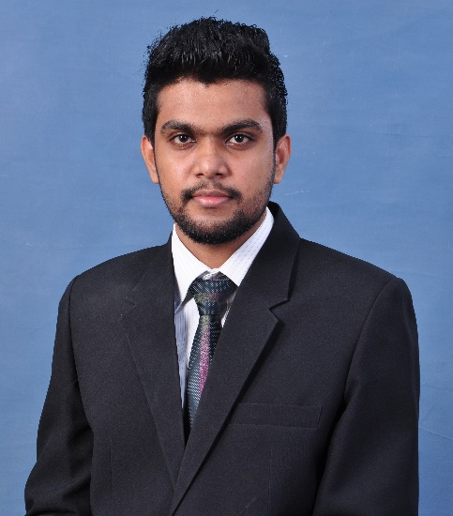
IT17153096 | J. M. S. d. Jayasundara
Specializing in Information Technology
IT17153096 | J.M.S.D.Jayasundara| 2020-009

Slide 29
The question presenter
IT17153096 | J.M.S.D.Jayasundara| 2020-009

Slide 30
Background & Research Gap
Most of the students struggle near the exams because they couldn’t find questions and answers according to their lecture notes.
The Question presenter is designed to do three particular tasks.
WH-Question generator according to the summarize note.
Gap-Fill Questions generator according to the summarize note.
QA System using keywords.
IT17153096 | J.M.S.D.Jayasundara| 2020-009

Slide 31
Background & Research Gap Cont.
There some previous researcher done on these question generation methods.[01]
There are also researchers done on Question Answering System is to search online answers for relatable questions using keywords. [02]
No product or research has both functionalities of question presenter as one product.
IT17153096 | J.M.S.D.Jayasundara| 2020-009

Slide 32
Research Question
Today, education is the most important and valuable way of achieving success. [03]
This application generates wh-questions and gap-fill questions according to summarize note.
The Question presenter component help student to get more questions & answers for their modules. [04]
After that , students are able to find answers using keywords.
IT17153096 | J.M.S.D.Jayasundara| 2020-009

Slide 33
Research Question cont.
This application generates WH-questions, Gap-Fill questions and answers. This component can be divided three main objectives
WH-Question Generator.
Gap-Fill Question Generator.
Question Answering System.
IT17153096 | J.M.S.D.Jayasundara| 2020-009

Slide 34
Objectives
Generate the WH-questions analyzing each sentences and paragraphs.
Generate Gap-Fill questions according to summarize note.
Develop the QA system.
In here user can search their questions. It will automatically Google search and display answers.
IT17153096 | J.M.S.D.Jayasundara| 2020-009

Slide 35

Methodology
Created summarized
note
Generate WH-questions & Gap-Fill questions
Display Questions
Student can refer to the summarized note
Check the given keywords
Automatic Google search
IT17153096 | J.M.S.D.Jayasundara| 2020-009

Slide 36
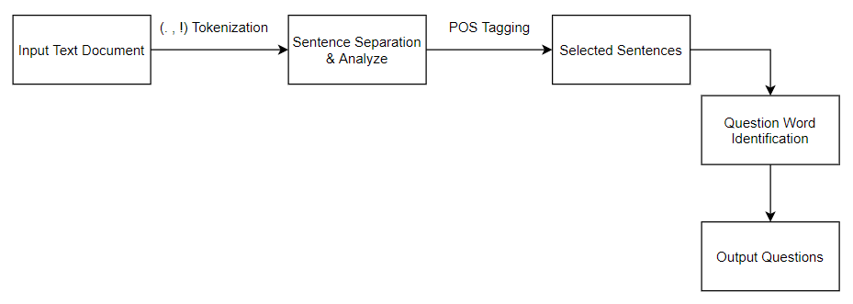
Methodology cont.
Generate WH-questions and Gap-Fill questions according to summarize note.
IT17153096 | J.M.S.D.Jayasundara| 2020-009

Slide 37
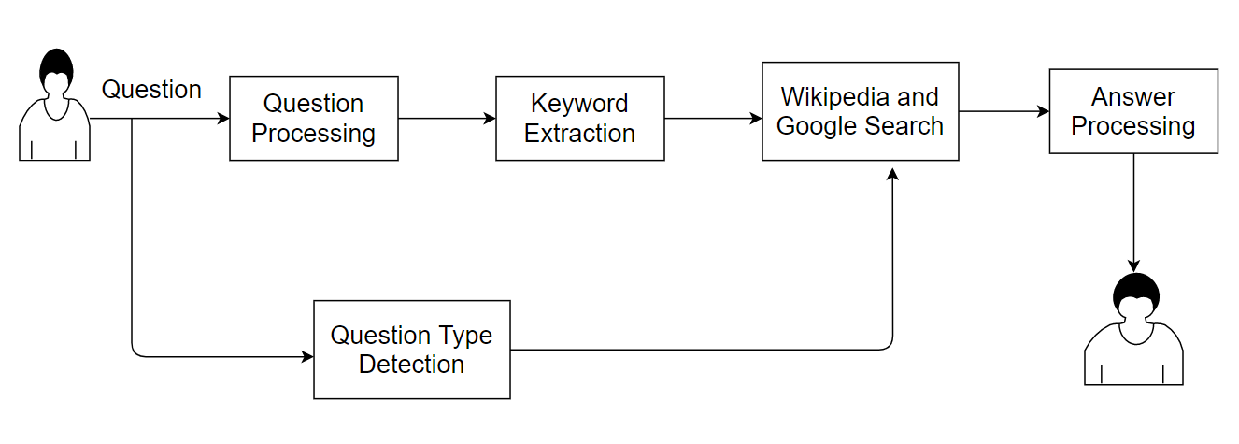
Methodology cont.
Question Answering System. It’s Open Domain system.
IT17153096 | J.M.S.D.Jayasundara| 2020-009

Slide 38
Achievements
Create meaningful WH-questions and gap-fill questions according to summarize note.
Recently, there are so many search engines available in the world. But the questions is those search engines gives so many links and outputs. So using this QA systems we achieve this issue successfully.
IT17153096 | J.M.S.D.Jayasundara| 2020-009

Slide 39
References
[1] A.Baid, I. Rae, J. Li, A. Doan, and J.Naughton “Toward Scalable Keyword Search over Relational Data,” Proceedings of the VLDB En-dowment, vol. 3, no. 1, pp. 140–149, 2010.
[2] Maria Vargas-Vera and Miltiadis D Lytras. Aqua: A closed-domain question answering system. Information Systems Management, 27(3):217– 225, 2010.
[3] Aimee A. Callender and Mark A. McDaniel. The bene_ts of embedded question ad-juncts for low and high structure builders. Journal Of Educational Psychology (2007), pages 339{348, 2007.
[4] Sanglap Sarkar, Venkateshwar Rao, Baala Mithra SM, Subrahmanya VRK Rao(2015)“NLP Algorithm Based Question and Answering System”, Proceedings of 2015 Seventh International Conference on Computational Intelligence, Modelling and SimulationPages 97-101
IT17153096 | J.M.S.D.Jayasundara| 2020-009

Slide 40
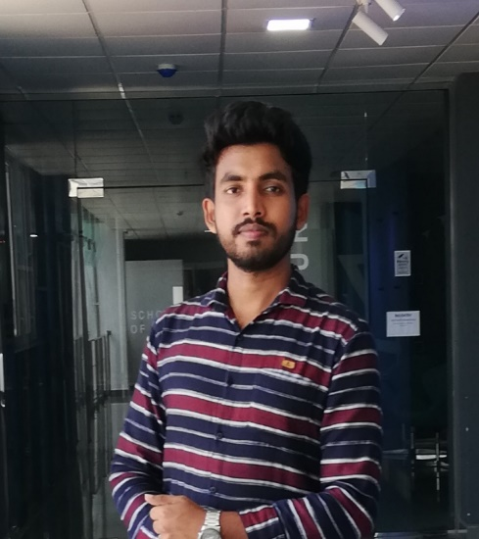
IT17106634 | l. a. p. y. p. Nuwanjaya
Specializing in Software Engineering
IT17106634 | Nuwanjaya L.A.P.Y.P | 2020-009

Slide 41
The slide matcher
IT17106634 | Nuwanjaya L.A.P.Y.P | 2020-009

Slide 42
Background & Research Gap
Students who study smart instead of study hard, can have a success in their education.
EduEasy is an E-learning application for students to effectively learn and revise lectures done at university.
The Slide Matcher is designed to do a tasks
Matching the relevant lecture slide content according to the generated summarized note.
IT17106634 | Nuwanjaya L.A.P.Y.P | 2020-009

Slide 43
Background & Research Gap cont.
Comparing the text between summarized note and lecture content.
There are some researches done based on text classification, measure text similarity. [4]-[6].
Natural Language Processing (NLP) is a part of computer science and AI which deals with human languages[3][1].
Get the data in clean and standard format for further analysis is very important
IT17106634 | Nuwanjaya L.A.P.Y.P | 2020-009

Slide 44
Background & Research Gap cont.
Copyleaks, TextAnalizer, CountWordsFree are some of existing products.
TFIDF is a very common algorithm to transform text into numbers and identify the similarity [2].
IT17106634 | Nuwanjaya L.A.P.Y.P | 2020-009

Slide 45
Research Question
Students wastes their time to seek the relevant lecture slides while using references for short notes.
Normally students try to find the lecture notes manually.
Slide Matcher component helps students to find and navigate to the exact lecture note.
IT17106634 | Nuwanjaya L.A.P.Y.P | 2020-009

Slide 46
Objectives
Upload lecture PPTs to the system.
Upload summarized note content or relevant part of summarized note which has to be found the relevant lecture content.
Develop an algorithm to calculate the similarity.
Display the most similar lecture PPT.
Develop an attractive and easy to use user interface.
IT17106634 | Nuwanjaya L.A.P.Y.P | 2020-009

Slide 47
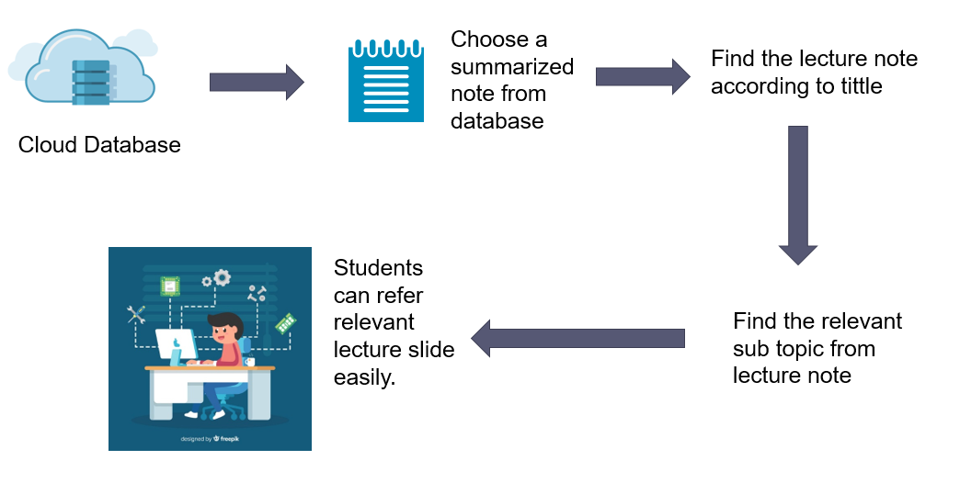
Methodology
IT17106634 | Nuwanjaya L.A.P.Y.P | 2020-009

Slide 48
Methodology cont.
Compare the similarity between summarized note and lecture content using Vector Counter pairwise technology.
Python 3.6, Anaconda Spyder, used as tool and technologies.
IT17106634 | Nuwanjaya L.A.P.Y.P | 2020-009

Slide 49
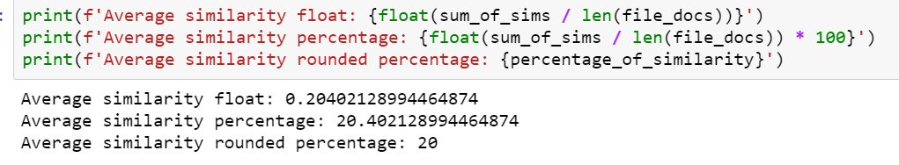
Achievements
Successfully developed an algorithm to find the most similar lecture PPTX from all lectures.
Developed an algorithm to calculate the percentage of similarity between summarized note and selected lecture slide..
IT17106634 | Nuwanjaya L.A.P.Y.P | 2020-009

Slide 50
References
[1] Omid Shashmirzadi, Adam Lugowski and Kenneth Younge, “Text Similarity in Vector Space Models. AComparative Study,” IEEE International Conference on Machine Learning and Application (ICMLA), Boca Raton, FL, USA, USA, Dec 2019 pp, 19378206
[2] LajanugenLogeswaran, HonglakLee, DragomirRadev “Sentence Orderingand Coherence Modeling Using Recurrent Neural Networks” Department of Computer Science & Engineering, University of Michigan 2Department of Computer Science, Yale University, The Thirty-Second AAAI Conference on Artificial Intelligence (AAAI-18)
[3] Adrien Sieg “Text Similarities : Estimate the degree of similarity between two texts”. Available (https://medium.com/@adriensieg/text-similarities-da019229c894)
IT17106634 | Nuwanjaya L.A.P.Y.P | 2020-009

